Slide 1
GUESSING GAME
Project creator :
GYANARANJAN BISWAL(2210990354)
Welcome everyone! Today, we'll delve into some Python code for a fun guessing game with two exciting variations. In the first variation, you'll try to guess a random number chosen by the computer. In the second variation, the tables are turned, and the computer will attempt to guess a number you pick! Both variations use logic and are a great introduction to programming concepts.

Slide 2

Python is a powerful and versatile programming language that's widely used for various purposes, including web development, data science, and even machine learning. One of its strengths is its readability, making it a perfect language for beginners to learn programming concepts. Today, we'll leverage Python's capabilities to create two fun guessing games.

Slide 3
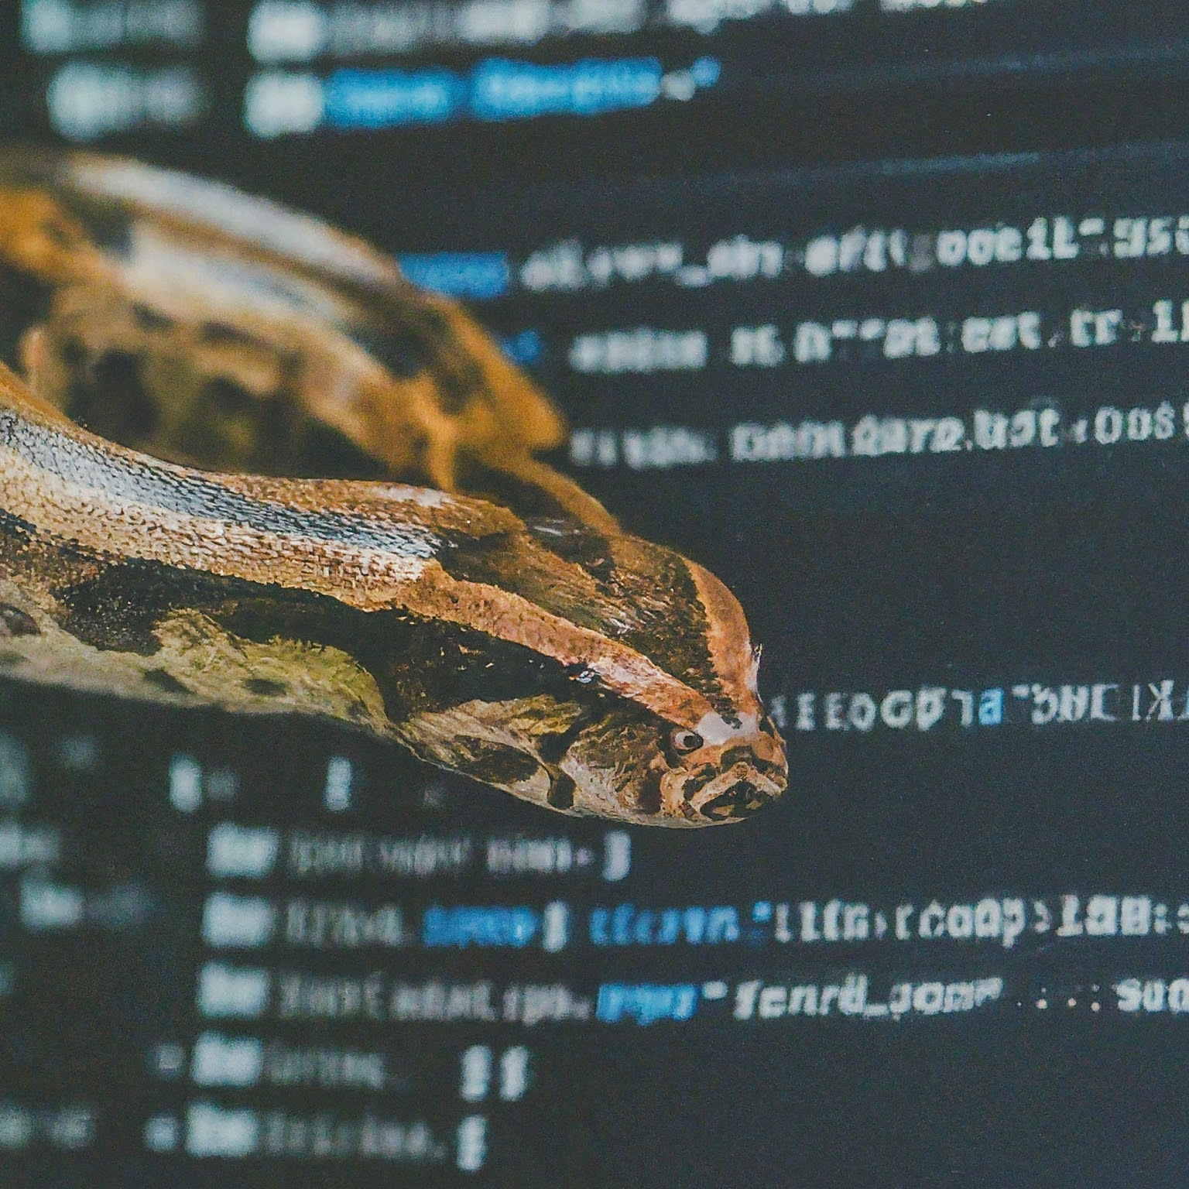
Guess a random number chosen by the computer.
We define a function called guess(x).
The x parameter sets the upper limit for the random number.
The first game we'll explore is called the user guessing game. In this variation, you'll try to guess a random number secretly chosen by the computer. To create this functionality, we define a function named guess(x). This function takes one parameter, x, which sets the highest possible value the computer's random number can be.

Slide 4

Generating the Random Number
The computer picks a secret number.
We use random.randint(1, x) to generate the random number.
This function picks a random integer between 1 and x.
Inside the guess(x) function, we use the random library's randint(1, x) function. This function generates a random integer between 1 (inclusive) and the value of x (inclusive). This random number is stored by the computer, but it won't be revealed to you yet.

Slide 5
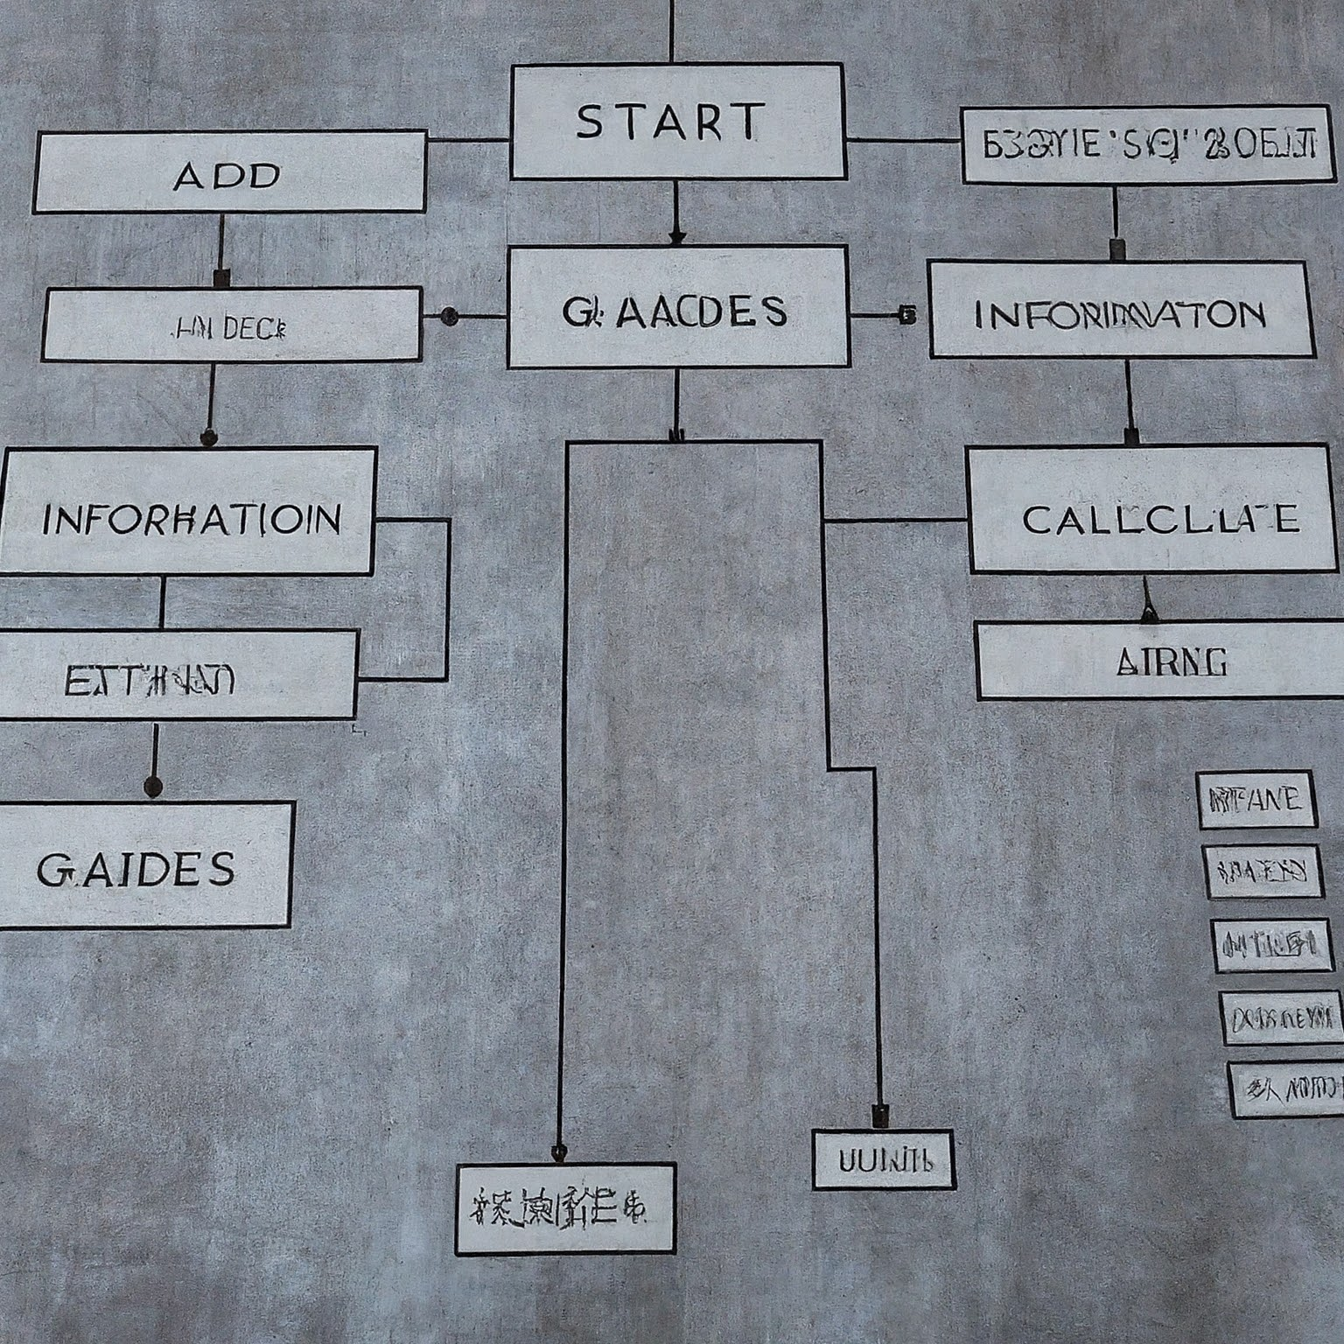
The Guessing Loop
The loop continues until your guess is correct.
We use a while loop that continues as long as your guess (guess) is not equal to the random number (random_number).
Inside the loop, you'll be prompted to enter your guess.
Speaker Notes
The core part of the user guessing game is a while loop. This loop keeps running until you manage to guess the correct number. Inside the loop, you'll be prompted to enter your guess using an input statement. Once you enter your guess and press enter, the program will check if it's the correct answer.

Slide 6

Checking Your Guess
The program checks if your guess is correct.
An if statement checks if your guess is lower than the random number.
If your guess is lower, a message is displayed indicating you need to guess higher.
There's a similar elif statement for guesses that are too high.
An if statement checks if your guess (guess) is lower than the random number (random_number). If your guess is lower, a message is displayed prompting you to guess higher. There's a similar elif statement that checks for guesses that are too high. This way, the program provides hints to guide

Slide 7
Thanks!

